Slide 1


INDIA | UAE
UAE Corporate Taxation
By Rajat Mohan

Slide 2

Table of Content
INDIA | UAE
UAE - Demographics
Treatment of Business Losses
Basics
Related Persons
Accounting Profit vs Taxable Income
Tax Compliance
Expense Deductibility
Penalty Provisions
Whom to Tax?
India UAE Comparison
Corporate Tax Rates
Abbreviations
Tax groups
About Us

Slide 3

UAE- Demographics

Slide 4
KEY MILESTONES IN UAE HISTORY
INDIA | UAE
1900 onwards
December 2, 1971
Trucial States
under British protection
Formation of the UAE (6 Emirates)
2010
1972
Launch of UAE Vision 2021
Ras Al Khaimah joined
UAE
2017
c
2018
Excise Tax Law
Introduction of VAT @ 5%
v
2023
2022
Corporate Tax became
effective
Introduction of Corporate Tax

Slide 5
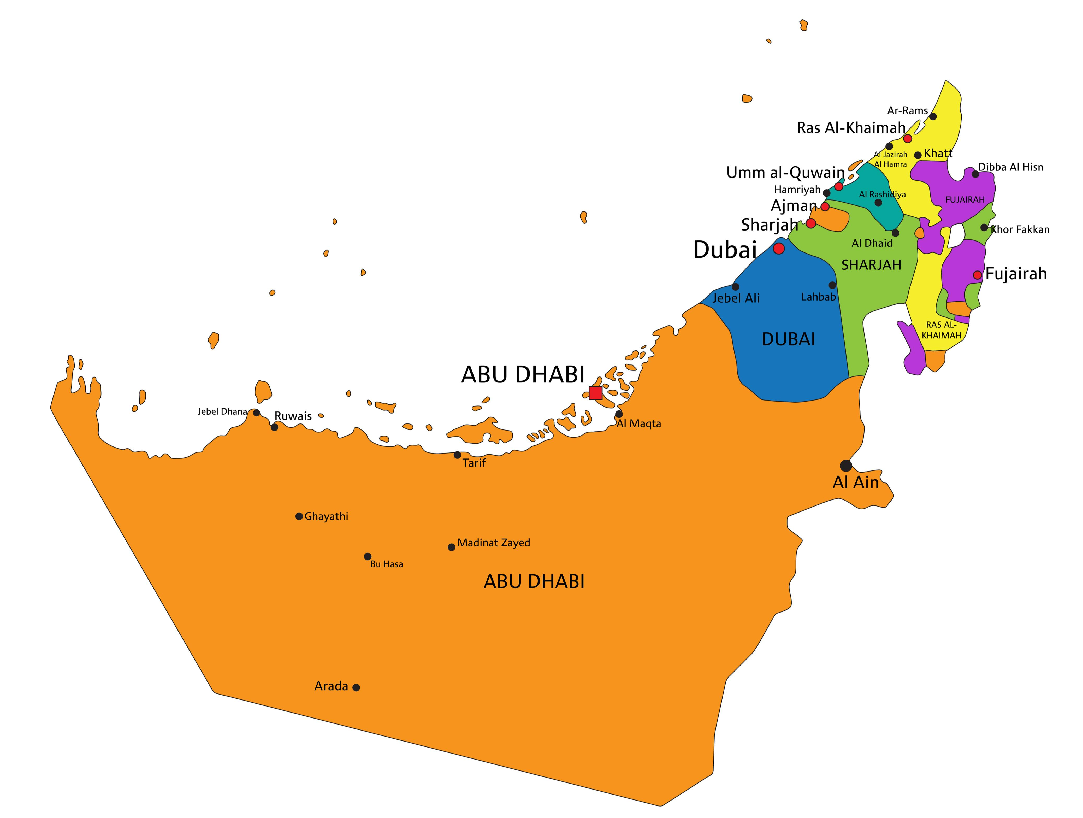
UNITED ARAB EMIRATES: MAP AND KEY STATISTICS BY EMIRATE
INDIA | UAE
Emirate | Capital | Area (km²) | Population (approx.) | GDP (USD bn)
Abu Dhabi | Abu Dhabi City | ~67,340 | ~3.78 M | ~219
Dubai | Dubai City | ~4,114 | ~3.94 M | ~138
Sharjah | Sharjah City | ~2,590 | ~1.8 M | ~56
Ajman | Ajman City | ~260 | ~0.5 M | ~10.9
Ras Al Khaimah | Ras Al Khaimah City | ~2,486 | ~0.4 M | ~14.3
Fujairah | Fujairah City | ~1,166 | ~0.32 M | ~6.8
Umm Al Quwain | Umm Al Quwain City | ~720 | ~0.05 M | ~0.7

Slide 6
UAE GOVERNANCE AND TAX ADMINISTRATION STRUCTURE
INDIA | UAE
Federal Supreme
Council
(Rulers of the Seven
Emirates)
President &
Vice President
Council of
Ministers
(UAE Cabinet)
Ministry of
Finance
The highest
constitutional
authority in the
UAE
Federal Tax
Authority
The executive
leaders of the
UAE
The cabinet
responsible for
government
policy
Oversees tax
policy and
legislation
Administers
and enforces
tax laws
Issues Cabinet Decisions
Issues Ministerial Decisions
Issues FTA Decisions

Slide 7
BASICS

Slide 8
KEY LEGISLATION APPLICABLE TO UAE CORPORATE TAX
INDIA | UAE
S. No. | Legislation / Instrument | Year | Number of Articles / Decisions | Role in Corporate Tax Framework
1 | Federal Decree-Law No. 47 of 2022 on the Taxation of Corporations and Businesses | 2022 | 70 Articles | Primary legislation establishing the Corporate Tax regime in the UAE.
2 | Federal Decree-Law No. 28 of 2022 on Tax Procedures | 2022 | 57 Articles | Provides the procedural framework for Corporate Tax Law.
3 | Cabinet Decisions issued under the Corporate Tax Law | 2022 onwards | Multiple Decisions (15+ issued) | Provide detailed implementing rules required for applying the Corporate Tax Law, including provisions relating to Free Zone taxation, qualifying income, and other operational aspects.
4 | Ministerial Decisions issued under the Corporate Tax Law | 2023 onwards | Multiple Decisions (20+ issued) | Provide technical and administrative rules such as definitions of related parties, transfer pricing documentation thresholds, small business relief, and other detailed provisions.
5 | Federal Tax Authority Decisions | 2023 onwards | Multiple decisions issued periodically | Provide administrative directions and operational rules for implementing Corporate Tax procedures, compliance requirements, and taxpayer obligations.
6 | Administrative Guidance, Public Clarifications and Guides | Ongoing | Various Guides and Clarifications issued periodically | Provide interpretative guidance and practical instructions to assist taxpayers in complying with Corporate Tax law and related decisions.

Slide 9
OVERVIEW OF UAE CORPORATE TAX LAW
INDIA | UAE
The UAE Corporate Tax regime was introduced through Federal Decree-Law No. 47 of 2022, marking the UAE’s first comprehensive federal direct tax on business profits.
The law applies to Taxable Income earned by a Taxable Person during a Tax Period, and Corporate Tax is imposed at the rates specified under the law.
Corporate Tax operates under a self-assessment system, where the responsibility to calculate, declare, and pay tax lies with the business itself.
The law applies uniformly across the UAE and establishes a structured, transparent, and rules-based tax framework aligned with international standards.

Slide 10
WHAT IS CORPORATE TAX?
INDIA | UAE
The UAE Corporate Tax regime applies to Tax Periods commencing on or after 1 June 2023. Corporate Tax is imposed on the Taxable Income earned during a Tax Period.
Each Taxable Person is required to determine its Tax Period and comply with Corporate Tax obligations for that period.
A Tax Return must be filed within nine months from the end of the relevant Tax Period, in accordance with the Corporate Tax Law.
Corporate Tax liability arises on an annual basis, with one return filed for each Tax Period.
Any change in the Tax Period requires approval from the Authority, as prescribed under the law

Slide 11
WHO IS A “PERSON”?
INDIA | UAE
Person
Resident
State Sourced Income
Non-Resident
UAE Juridical Persons
Foreign Juridical Persons
Natural Persons
Permanent Establishment
Other UAE nexus
Cabinet Decisions
Taxable Person
Exempt Person
Automatically Exempt Persons
Government Entities
Government Controlled Entities
Extractive Business
Non-Extractive Natural Resource Business
Qualifying Public Benefit Entities
Persons that must apply to the Authority
Qualifying Investment Funds
Pension Funds
Wholly Owned Juridical Persons
#refer Article 4 and 10 of Federal Decree-Law 47 of 2022

Slide 12
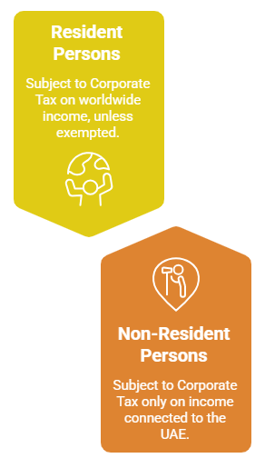
TAXABILITY OF A TAXABLE PERSON?
INDIA | UAE
Taxable Persons are broadly classified into:
  Resident Persons
  Non-Resident Persons
Resident Persons subjected to Corporate Tax are:
  Juridical persons incorporated in UAE;
  Juridical persons effectively managed and controlled in the UAE;
  Natural persons conducting a Business or Business Activity in the UAE.
Non-Resident Persons subjected to Corporate Tax are:
  Have a Permanent Establishment in the UAE
  Derive UAE-sourced income
  Have a nexus in the UAE as specified under the law
#refer Article 10 of Federal Decree-Law 47 of 2022

Slide 13
TAX PERIOD & FINANCIAL YEAR CONCEPT
INDIA | UAE
Financial year ending 31 December 2024 →
First Tax Period: 1 January 2024 to 31 December 2024
Financial year ending 31 March 2025 →
First Tax Period: 1 April 2024 to 31 March, 2025
Illustration – First
Tax Period
Definition of Tax Period
Changes to Tax
Period
12-month financial year for
accounting purposes.
Calendar year or Non-calendar year?
Any change to the Tax Period or financial year requires prior approval from the FTA
#refer Article 57 of Federal Decree-Law 47 of 2022

Slide 14
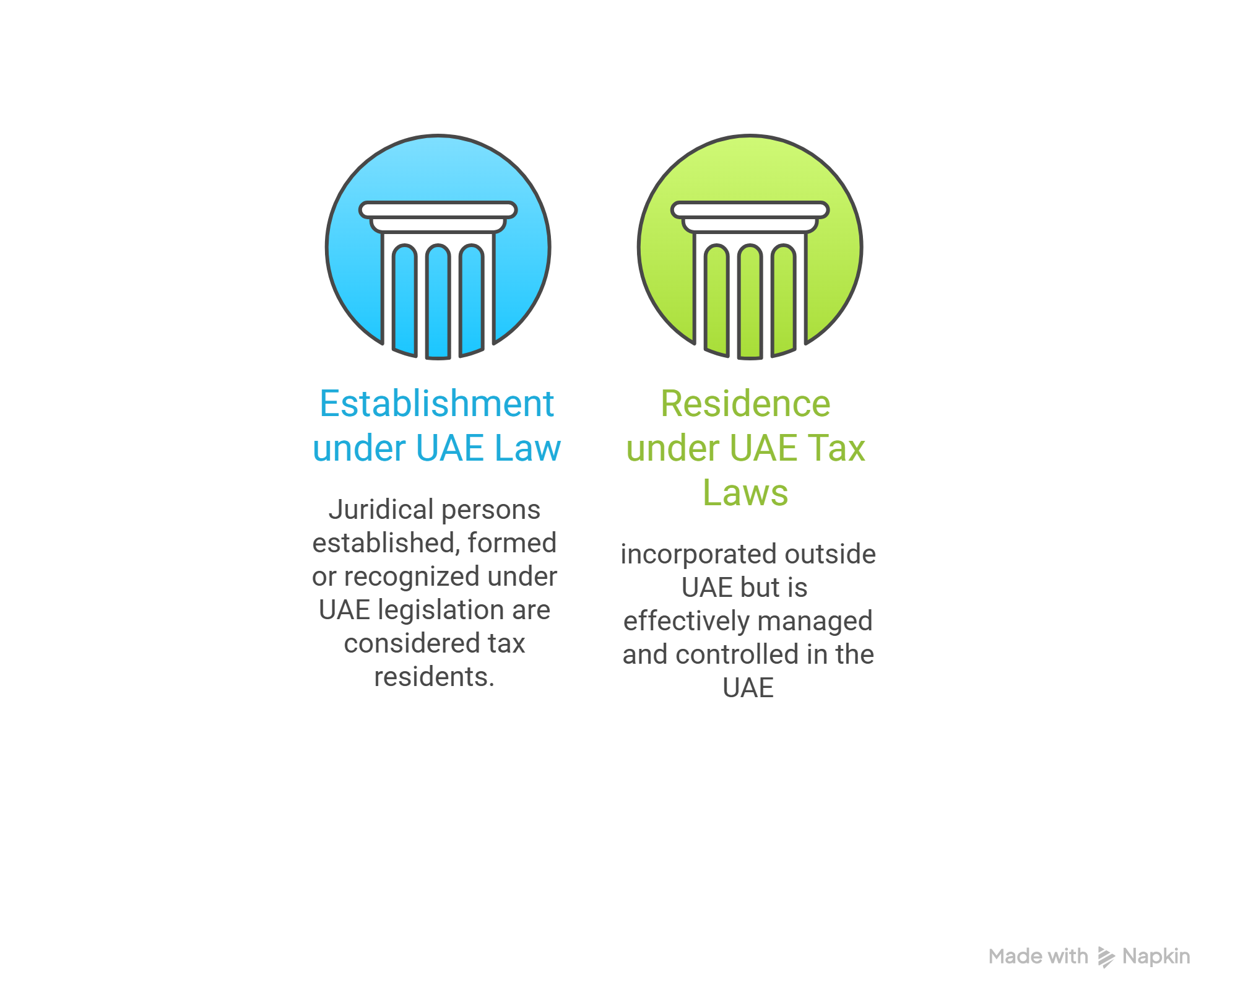
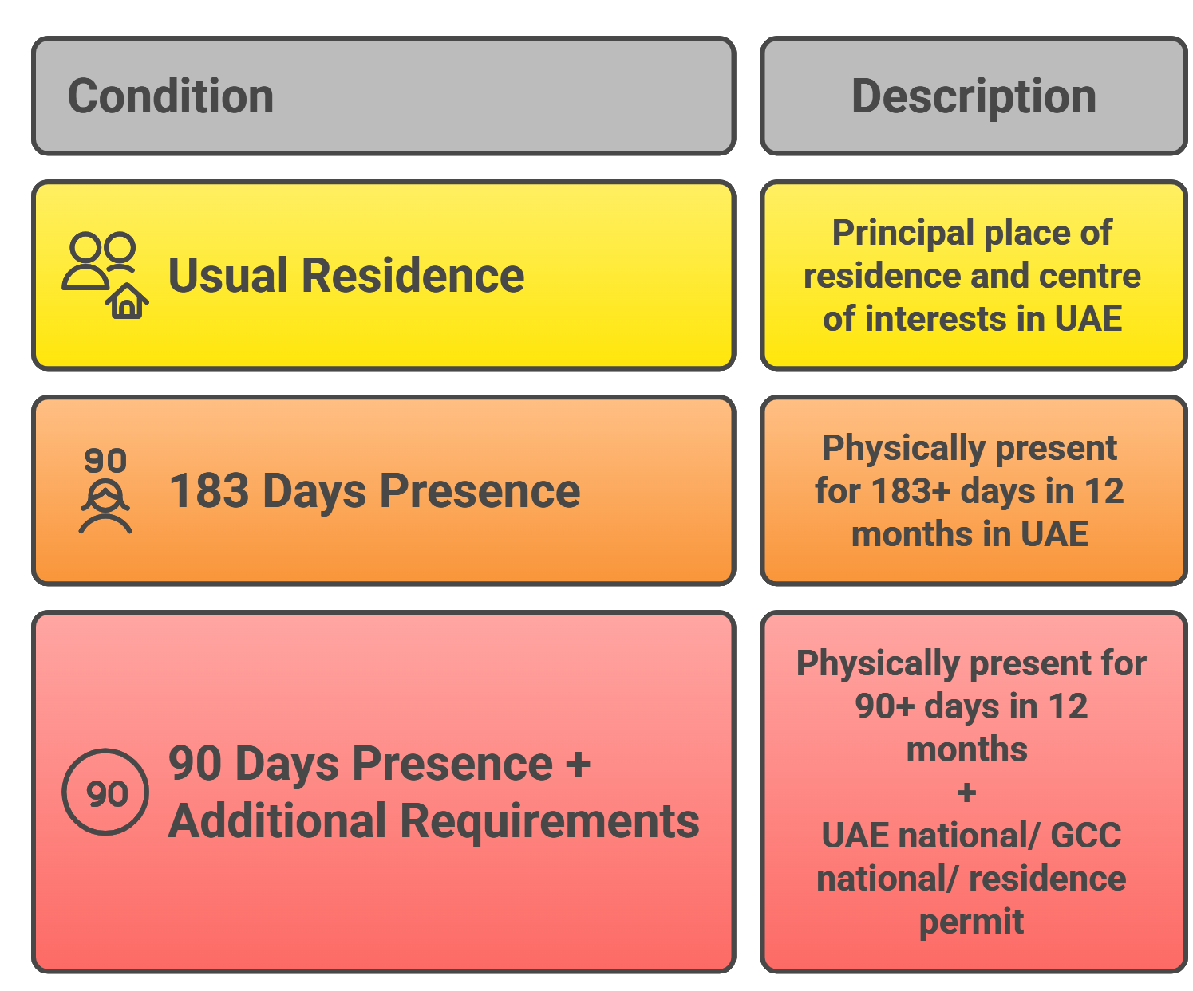
RESIDENCY CRITERIA
INDIA | UAE
LEGAL PERSON
NATURAL PERSON
#refer CD 85 of 2022 Concerning Determining the Tax Residence

Slide 15
Accounting Profit vs Taxable Income

Slide 16
ACCOUNTING PROFIT VS TAXABLE INCOME
INDIA | UAE
The UAE Corporate Tax Law uses Accounting Income as the starting point for determining Taxable Income.
Accounting Income is the net profit or loss before tax, as reported in the financial statements.
This Accounting Income is then adjusted for specific items prescribed under the Corporate Tax Law to arrive at Taxable Income.
#refer Article 20 of Federal Decree-Law 47 of 2022

Slide 17
BASIS OF ACCOUNTING IN FINANCIAL STATEMENTS
INDIA | UAE
Accounting Standards
Financial statements must generally be prepared using IFRS or IFRS for SMEs.
Accrual Basis of Accounting
The accrual basis is the standard method for preparing financial statements.
Income and expenses are recognized when earned or incurred, irrespective of when cash is received or paid.
Cash Basis of Accounting
A person may prepare financial statements using the cash basis of accounting where revenue does not exceed AED 3 million.
Under this method, income and expenses are recognized when cash is actually received or paid.
#refer Article 54 of Federal Decree-Law 47 of 2022

Slide 18
GENERAL RULES FOR DETERMINING TAXABLE INCOME
INDIA | UAE
Taxable Income is computed for each Tax Period, generally aligned with the financial year
Accounting treatment applies unless the Corporate Tax Law prescribes a different tax treatment
Key adjustments to accounting profit
  Removal of exempt income
  Adjustments for unrealised gains and losses, where applicable
  Deductions for allowable business expenditure, subject to limitations
  Reliefs for group transfers and business restructuring
  Adjustments for Related Party and Connected Person transactions based on Market Value
  Set-off and utilisation of Tax Losses, subject to prescribed conditions
Recognition of unrealized gains and losses
  Taxable Persons using accrual accounting may elect to apply a realisation basis
  Election prevents taxation of unrealised gains where no cash is received
Change in accounting method
  Change from cash to accrual basis may be permitted, subject to approval
  Changes apply from the beginning of a Tax Period
#refer Article 20 of Federal Decree-Law 47 of 2022

Slide 19
Expense Deductibility

Slide 20
DEDUCTIBLE EXPENDITURE
INDIA | UAE
INTEREST EXPENDITURE
Interest is generally deductible in the Tax Period incurred
Subject to:
General Interest Limitation:
Deduction restricted to 30% of EBITDA, only if Net Interest > AED 12 million
Carry forward of disallowed interest for 10 Tax Periods
GENERAL RULE
Expenditure is deductible if it is:
Wholly and exclusively incurred for business purposes, and
Revenue in nature, and
Incurred during the relevant Tax Period
ENTERTAINMENT EXPENDITURE
50% of entertainment expenses other than employees is deductible without apportionment
Covers meals, accommodation, travel, events, and similar business entertainment
100% deduction allowed for entertainment incurred exclusively for employees
MIXED-PURPOSE EXPENDITURE:
Where an expense is partly business and partly non-business,
Only the business portion is deductible, based on a fair and reasonable apportionment
#refer Article 28 to 32 of Federal Decree-Law 47 of 2022

Slide 21
NON-DEDUCTIBLE EXPENDITURE
INDIA | UAE
Non-deductible expenditure includes:
  Donations, grants, and gifts, except where made to Qualifying Public Benefit Entities
  Fines, penalties, bribes, and illicit payments, except where payments are compensatory in nature, or arise from a breach of contract
  Dividends and profit distributions to owners, including payments linked to profits rather than business activity
  Personal drawings or withdrawals by individuals carrying on a Business
  Distributions or allocations to partners of an Unincorporated Partnership
  Recoverable input VAT, UAE Corporate Tax, and foreign income taxes
  Expenses not incurred for business purposes
  Expenses incurred to earn Exempt Income
  Losses not connected with the business
  The Cabinet may prescribe additional non-deductible items through future decisions.
#refer Article 33 of Federal Decree-Law 47 of 2022

Slide 22
Whom to Tax?

Slide 23
CORPORATE TAX APPLICABILITY FOR INDIVIDUALS
INDIA | UAE
Individuals are subject to UAE Corporate Tax only where they conduct a Business or Business Activity in the UAE and their total Business Turnover exceeds AED 1 million in a calendar year.
Personal income earned by individuals is outside the scope of Corporate Tax, including:
  Salary and employment income
  Personal investment income not linked to a business activity
Corporate Tax may apply to individuals carrying on:
  Professional or consultancy activities
  Commercial or trading activities
  Any other activity conducted regularly and independently for profit
Once treated as a Taxable Person, the individual must:
  Register for Corporate Tax
  File an annual Corporate Tax Return
Income from sale of property by an individual as one-time activity is not business and not chargeable to corporate tax
#refer Article 12 of Federal Decree-Law 47 of 2022

Slide 24
TAXATION: UNINCORPORATED PARTNERSHIP
INDIA | UAE
By default, the partnership is fiscally transparent and not a separate taxable person
The business is treated as being carried on by the partners themselves, not by the partnership
Assets, liabilities, income, and expenses are allocated to partners based on their distributive share
Each partner is taxed individually on their proportionate share of partnership income
Key tax treatments
  Expenses incurred directly by a partner for partnership business are deductible at partner level
  Interest paid by the partnership on partners’ capital is not deductible and is treated as income allocation
  Foreign tax paid at partnership level is passed through to partners and credit is allowed proportionately
Optional tax treatment
Partners may elect for the partnership to be treated as a separate taxable person
Where elected:
  The partnership becomes the Taxable Person
  Partners remain jointly and severally liable for Corporate Tax
  One partner must be appointed to manage Corporate Tax compliance
#refer Article 16 of Federal Decree-Law 47 of 2022

Slide 25
EXEMPT PERSONS
INDIA | UAE
Qualifying
Investment
Funds
Public Benefit
Entities
Other Persons
Government
Entities
Extractive
Businesses
Examples are:
REITs
Private Equity fund
Hedge Fund
Mutual Funds
Other persons as
may be specified by
Cabinet or
Ministerial
Decisions.
Approved charities,
foundations, and
not-for-profit
organisations.
Entities carrying out
sovereign or public
functions.
Businesses engaged
in the extraction of
natural resources.
Government
Controlled
Entities
Non-Extractive
Natural
Resource
Businesses
Qualifying
Public Pension
Funds
Wholly Owned
Subsidiaries
Subsidiaries of
exempt persons
satisfying
ownership
conditions.
Entities wholly
owned or controlled
by the government.
UAE and foreign
pension funds
meeting regulatory
conditions.
Activities closely
linked to extractive
operations.
#refer Article 4 of Federal Decree-Law 47 of 2022

Slide 26
Corporate Tax Rates

Slide 27
CORPORATE TAX RATES
INDIA | UAE
Corporate Tax is levied at:
  0% on Taxable Income up to AED 375,000
  9% on Taxable Income exceeding AED 375,000
These rates apply uniformly across all Emirates and business sectors, unless a specific exemption or relief applies.
In the case of a Qualifying Free Zone Person:
  0% Corporate Tax applies to Qualifying Income; and
  9% Corporate Tax applies to income that is not Qualifying Income.
Natural persons conducting business are subject to Corporate Tax only if business turnover exceeds AED 1 million in a calendar year.
Small Business Relief (SBR) may be available where revenue does not exceed AED 3 million, where NIL Corporate Tax is payable
0%
9%
Taxable
Income up to
AED 375,000
Taxable
Income
exceeding AED
375,000
No tax on income
below this threshold.
Tax rate applies to
income above the
threshold.
#refer Article 3 of Federal Decree-Law 47 of 2022

Slide 28
SMALL BUSINESS RELIEF
INDIA | UAE
Small Business Relief (SBR) is available to Resident Persons only under the UAE Corporate Tax regime.
A business is eligible to elect SBR if its Revenue does not exceed AED 3 million in the relevant Tax Period.
Where SBR is elected:
  The business is treated as having no Taxable Income for that Tax Period
  Corporate Tax payable = NIL, irrespective of actual profit
SBR cannot be applied by:
  Non-Resident Persons
  Members of Multinational Enterprise Groups
  Businesses that choose not to elect the relief.
Even when SBR is applied, the business must still:
  Register for Corporate Tax
  File a Corporate Tax Return
  Maintain sufficient records to support revenue eligibility
SBR is intended as a temporary transition relief available for the tax period ending on or before 31st December, 2026
.
#refer Article 21 of Federal Decree-Law 47 of 2022

Slide 29
GLOBAL TAX RATES
INDIA | UAE
Countries | Personal Income Tax | Corporate Tax
Bahrain | 0% | 0%
India | 39.00% | 34.94%
Kuwait | 0% | 7%-16%
Oman | 0% | 15.00%
Qatar | 0% | 10%
Saudi Arabia | 0% | 2.5%-15%
Singapore | 24.00% | 17.00%
United Arab Emirates | 0% | 9.00%
United Kingdom | 45.00% | 25.00%
United States | 37.00% | 21.00%

Slide 30
Tax Groups

Slide 31
TAXATION: TAX GROUP
INDIA | UAE
Multiple Resident juridical persons may elect to be treated as one single taxable entity for Corporate Tax purposes
All group members are consolidated and treated as one Taxable Person, represented by the Parent Company
Intra-group transactions are generally ignored, and profits of one entity can offset losses of another
Formation requires ≥95% ownership (share capital, voting rights, and profit/net asset entitlement), direct or indirect
All members must:
  Be resident,
  Not be Exempt Persons or Qualifying Free Zone Persons, and
  Have the same financial year and accounting standards
The Parent Company is responsible for registration, filing, tax payment, refunds, and consolidated records
Joint and several liability applies to all members for Corporate Tax and penalties
Taxable Income is computed at group level, with thresholds and limits tested on consolidated results
Tax losses are ring-fenced:
Pre-grouping losses can be used only against income of the same entity
Losses generally stay with the group when members exit
Anti-avoidance rule applies where assets are transferred and a member exits the group within two years
#refer Article 40 of Federal Decree-Law 47 of 2022

Slide 32
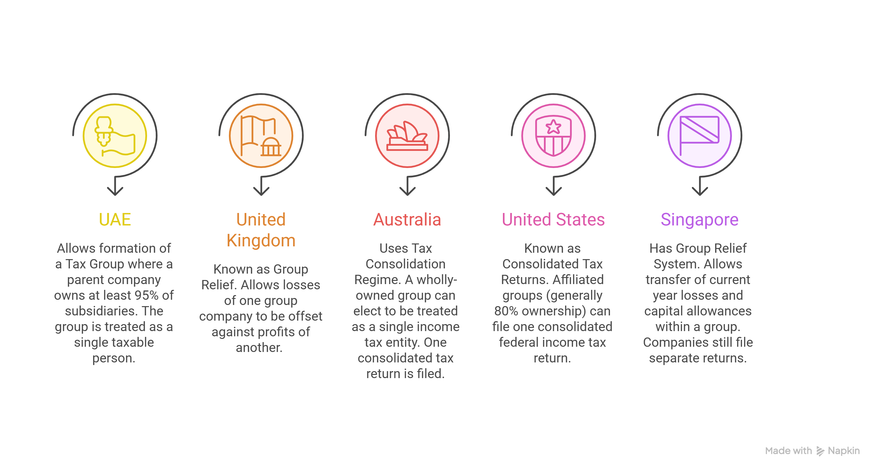
COUNTRIES WITH TAX GROUP / TAX CONSOLIDATION REGIME
INDIA | UAE

Slide 33
TRANSFERS WITHIN A QUALIFYING GROUP
INDIA | UAE
Provides tax neutrality for intra-group transfers of assets or liabilities undertaken as part of internal reorganisations
Transfer is treated as occurring at net book value, resulting in no immediate taxable gain or loss
Applies only where both parties are juridical persons and meet all qualifying conditions
Minimum 75% direct or indirect ownership must exist between the entities (or through a common parent)
Both entities must:
  Be UAE Resident Persons or Non-Residents with a UAE Permanent Establishment
  Not be Exempt Persons or Qualifying Free Zone Persons
  Have the same financial year and same accounting standards
Relief applies only if an irrevocable election is made in the Tax Return for the transfer period
Two-year continuity rule applies:
  Relief is clawed back if the asset is transferred outside the group, or
  Group relationship ceases within two years
#refer Article 26 of Federal Decree-Law 47 of 2022

Slide 34
BUSINESS RESTRUCTURING RELIEF
INDIA | UAE
Provides Corporate Tax neutrality for genuine business reorganizations that preserve economic ownership
Applies to mergers, demergers, and transfers of a business or independent part of a business
Relief is available only where consideration consists solely of shares or ownership interests
All parties must:
  Be subject to UAE Corporate Tax
  Not be Exempt Persons or Qualifying Free Zone Persons (unless elected to be taxed)
  Have the same financial year and same accounting standards
Transaction must:
  Transfer the entire business or an independently operable part
  Be undertaken for valid commercial reasons
  Reflect economic reality and comply with UAE laws
Where conditions are met:
  No gain or loss arises on transfer
  Assets and liabilities transfer at net book value
  Tax base rolls over to the transferee (no step-up)
Two-year continuity requirement applies:
  Disposal of shares or the transferred business within two years triggers clawback
  Transaction is retrospectively treated at Market Value for tax purposes
#refer Article 27 of Federal Decree-Law 47 of 2022

Slide 35
Treatment of Business Losses

Slide 36
TREATMENT OF BUSINESS LOSSES
INDIA | UAE
Tax losses arise when allowable deductions exceed taxable income for a Tax Period.
UAE Corporate Tax allows carry forward of tax losses to offset future Taxable Income, subject to conditions.
Key Conditions:
  Losses can be carried forward indefinitely.
  Losses can be utilised up to 75% of Taxable Income in a future Tax Period. Remaining losses continue to be carried forward.
  At least 50% common ownership must be maintained from the loss year to the utilisation year.
  Tax losses arising from exempt income or income subject to 0% tax are not eligible for offset against taxable profits.
#refer Article 37 of Federal Decree-Law 47 of 2022

Slide 37
Related persons

Slide 38
ARM’S LENGTH PRINCIPLE
INDIA | UAE
Transactions between related parties must reflect prices and terms that independent parties would agree under comparable circumstances
Pricing must be driven by commercial substance and economic reality, not group relationships
Arm’s length outcomes may fall within a reasonable range, not a single point estimate
Functional analysis covering functions performed, assets used, and risks assumed is mandatory
Where results fall outside the arm’s length range, authority may adjust taxable income accordingly
Meaning of Related Parties
  Parties are considered related where ownership or control of 50% or more exists, directly or indirectly
  Control may exist through voting rights, profit entitlement, board appointment powers, or contractual influence
  Applies equally to UAE and foreign relationships
  Once a relationship exists, all transactions between such parties fall within scope
#refer Article 34 of Federal Decree-Law 47 of 2022

Slide 39
PAYMENTS TO CONNECTED PERSONS
INDIA | UAE
Payments to connected individuals are deductible only to the extent they reflect market value
Any excess over market value is automatically disallowed for tax purposes
Applies to salaries, bonuses, management fees, benefits, and similar payments
Market value must be supported through benchmarking or comparable analysis
Exception available for listed or regulated entities subject to independent oversight
Connected Person means:
  An owner of the Taxable Person.
  A director or officer at the Taxable Person.
  A Related Party of any of the Persons referred above
#refer Article 36 of Federal Decree-Law 47 of 2022

Slide 40
TRANSFER PRICING DOCUMENTATION
INDIA | UAE
The Federal Tax Authority may require a taxable person to submit a transfer pricing disclosure with the Corporate Tax return.
The disclosure contains information on transactions and arrangements with Related Parties and Connected Persons.
A taxable person must maintain Transfer Pricing documentation, consisting of:
  Master File – Provides information on the multinational group, including its global business operations and transfer pricing policies.
  Local File – Contains detailed information on related-party transactions undertaken by the taxable person in the UAE.
Thresholds for Maintaining Master File and Local File
Transfer pricing documentation is required where:
  The taxpayer is part of a Multinational Enterprise Group with consolidated revenue ≥ AED 3.15 billion, or
  The taxpayer’s revenue ≥ AED 200 million in the relevant tax period.
Documentation must be maintained by the taxpayer and submitted to the FTA upon request, within the 30 days of the request.
#refer Article 55 of Federal Decree-Law 47 of 2022

Slide 41
Tax Compliance

Slide 42
CORPORATE TAX REGISTRATION
INDIA | UAE
Every Taxable Person must register for Corporate Tax with the Federal Tax Authority.
Upon registration, the taxpayer is issued a Tax Registration Number (TRN).
Registration Timelines
Registration timelines vary depending on the category of taxpayer:
  Resident juridical persons – Within 3 months of incorporation for newly formed entities.
  Non-resident juridical persons – Upon the creation of a Permanent Establishment within 6 months.
  Non-resident juridical persons – Upon the creation of a nexus in the UAE, within 3 months.
  Natural persons conducting business – When business turnover exceeds the applicable threshold of AED 1 million.
Exceptions from Registration
The following persons are not required to register for Corporate Tax, unless they become taxable persons under the law:
Government entities
Government-controlled entities
Persons engaged in extractive businesses meeting the conditions of the Corporate Tax Law
Persons engaged in non-extractive natural resource businesses meeting the relevant conditions
Non-resident persons deriving only UAE-sourced income without a Permanent Establishment in the UAE
#refer Article 51 of Federal Decree-Law 47 of 2022

Slide 43
CORPORATE TAX RETURN FILING
INDIA | UAE
Every Taxable Person must file one Corporate Tax Return for each Tax Period, even if:
  The business has no profits or incurs losses, or
  0% tax applies (Small Business Relief / Free Zone status).
The Corporate Tax Return must be filed within 9 months from the end of the Tax Period.
Returns are filed electronically on the portal “EmaraTax” of the Federal Tax Authority.
#refer Article 53 of Federal Decree-Law 47 of 2022

Slide 44
Penalty Provisions

Slide 45
VIOLATIONS AND ADMINISTRATIVE PENALTIES
INDIA | UAE
S.No. | Violation | Penalty
1 | Not maintaining required books, records, or information as required under tax laws | • AED 10,000 per violation • AED 20,000 if the same violation is repeated within 24 months
2 | Not submitting tax-related data, records, or documents in Arabic when requested by the Authority | AED 5,000
3 | Not applying for deregistration within the prescribed time | AED 1,000 per month of delay, up to a maximum of AED 10,000
4 | Not informing the Authority about changes in tax registration details | • AED 1,000 per violation • AED 5,000 if repeated within 24 months
5 | Legal representative not informing the Authority about their appointment on time | AED 1,000 (payable from the legal representative’s own funds)
6 | Legal representative failing to file the Tax Return on time | • AED 500 per month (or part thereof) for the first 12 months • AED 1,000 per month thereafter Penalty starts from the day after the due date
7 | Registrant failing to submit the Tax Return on time | • AED 500 per month (or part thereof) for the first 12 months • AED 1,000 per month thereafter Penalty starts from the day after the due date

Slide 46
VIOLATIONS AND ADMINISTRATIVE PENALTIES
INDIA | UAE
S.No. | Violation | Penalty
8 | Failure to pay Corporate Tax by the due date | • Interest-type penalty at 14% per annum, charged monthly on unpaid tax • Due date is 20 business days from voluntary disclosure submission, or receipt of tax assessment
9 | Submitting an incorrect Tax Return | AED 500 (no penalty if corrected before the return due date)
10 | Submitting Voluntary Disclosure for tax errors | Monthly penalty of 1% of the tax difference from due date until Voluntary Disclosure is submitted
11 | Not submitting Voluntary Disclosure before being notified of a tax audit | • Fixed penalty of 15% of tax difference • Additional 1% per month on tax difference until Voluntary Disclosure or Tax Assessment
12 | Not cooperating with tax audit by taxpayer, tax agent, or legal representative | AED 20,000 (payable from own funds)
13 | Failure to submit or delay in submitting required declarations | • AED 500 per month (or part thereof) for first 12 months • AED 1,000 per month thereafter Penalty starts from the day after the due date
14 | Failure of a Taxable Person to apply for Corporate Tax registration within the time limit set by the Authority | AED 10,000

Slide 47
India UAE Comparison

Slide 48
COMPARATIVE TAXABILITY OF VARIOUS TYPES OF INCOME – INDIA VS UAE
INDIA | UAE
Nature of Income | Resident in India | Resident in UAE
Business Profits | Taxable under corporate or individual tax regime | Taxable under UAE Corporate Tax (0% up to AED 375,000, 9% thereafter)
Salary / Employment Income | Taxable in India | Not taxable (no personal income tax)
Rental Income (Immovable Property) | Taxable under Income from House Property | Not taxable if personal investment
Interest Income | Taxable | Not taxable if personal investment)
Dividend Income | Taxable in the hands of shareholders | Not taxable if personal investment
Capital Gains – Shares | Taxable | Not taxable if personal investment
Capital Gains – Immovable Property | Taxable | Not taxable if personal investment

Slide 49
TAXABILITY OF INCOME EARNED FROM INDIA BY UAE RESIDENT
INDIA | UAE
Nature of Income | Taxability in India | Taxability in UAE | DTAA Position
Salary earned in India | Taxable | Not taxable | India has exclusive right
Rental income from Indian property | Taxable | Not taxable (personal investment) | India has exclusive right
Interest income from India | Taxable | Not taxable | India may tax (max 12.5% DTAA rate)
Dividend from Indian company | Taxable | Not taxable | India may tax (max 10% DTAA rate)
Capital gain – immovable property in India | Taxable | Not taxable (personal investment) | India has exclusive right
Capital gain – shares of Indian company | Taxable | Not taxable (personal investment) | India has taxation right

Slide 50
TAXABILITY OF INCOME EARNED IN UAE BY A RESIDENT OF UAE
INDIA | UAE
Nature of Income | Taxability in UAE | Taxability in India | Remarks
Business profits | Taxable (0% up to AED 375,000; 9% thereafter) | Not taxable | UAE has exclusive right
Salary earned in UAE | Not taxable | Not taxable | Outside scope of UAE Corporate Tax
Rental income from UAE property# | Not taxable (personal investment) | Not taxable | No tax in both jurisdictions
Capital gains on UAE shares# | Not taxable (personal investment) | Not taxable | Outside Corporate Tax
Capital gains on UAE immovable property# | Not taxable (personal investment) | Not taxable | Outside Corporate Tax
Dividend income# | Not taxable (personal investment) | Not taxable | Outside Corporate Tax
Interest income# | Not taxable (personal investment) | Not taxable | Outside Corporate Tax

Slide 51
Abbreviations

Slide 52
ABBREVIATIONS
INDIA | UAE
ABBREVIATION | FULL FORM
AED | UAE Dirham (United Arab Emirates Dirham)
CD | Cabinet Decision
CT | Corporate Tax
FTA | Federal Tax Authority
GCC | Gulf Cooperation Council
MD | Ministerial Decision
PE | Permanent Establishment
SBR | Small Business Relief
VAT | Value Added Tax

Slide 53
About Us

Slide 54







About us
INDIA | UAE
Founded in 1984, the firm has grown consistently over four decades to become a recognized tax advisory practice
Professional Team of over 150 members.
Presence in UAE & India (Delhi, Mumbai, Dehradun)
100+ customers across the globe.
MISSION
VISION
"We grow with the growth of our clients"
“To provide solutions with
Honesty and Customer Satisfaction”

Slide 55

INDIA | UAE
CONTACT US
AMRG Global (India | United Arab Emirates)
Email: amrg@amrg.in | uae@amrg.in
LinkedIn: AMRG Global
Website : www.amrg.in

Slide 56
©2026 AMRG Global
Published in India. All rights reserved. No part of this publication may be reproduced, stored in a retrieval system, or transmitted, in any form, or by any means, electronic, mechanical, photocopying, recording, or otherwise without prior permission, in writing, from the publisher. This publication contains information in summary form and is therefore intended for general guidance only. It is not intended to be a substitute for detailed research or the exercise of professional judgment. Neither AMRG nor any other member of the firm can accept, any responsibility for loss occasioned to any person acting or refraining from action as a result of any material in this publication. The information contained in this communication is intended solely for the use of the addressee and others authorized to receive it. If you are not the intended recipient you are hereby notified that any disclosure, copying, distribution or taking any action in reliance on the contents of this information is strictly prohibited and may be unlawful. If you have received this communication in error, please notify us immediately by phone, fax or email and delete it from your system. AMRG Global is neither liable for the proper and complete transmission of the information contained in this communication nor for any delay in its receipt. In case you wish not to receive this information then do write back to the sender of this information, in case you have received it directly from AMRG servers then you can unsubscribe the same at www.amrg.in

Slide 57
THANK YOU

